Slide 1

Image Classification Using CNN
Name :- Gaurav singh
Branch :- Cse
Roll no. :- 18eebcs021

Slide 2
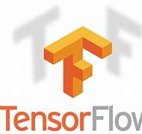
Project Description
Building a model to classify images into their appropriate categories using the intel-image-classification dataset.
Using CNN (python 3.6 and tensorflow)
● TensorFlow is an open-source software library for dataflow programming across a range of tasks. It is a symbolic math library, and is also used for machine learning applications such as neural networks.

Slide 3
The intel-image-classification Dataset
This Data contains around 25k images of size 150x150 distributed under 6 categories. {'buildings' -> 0, 'forest' -> 1, 'glacier' -> 2, 'mountain' -> 3, 'sea' -> 4, 'street' -> 5 }

Slide 4
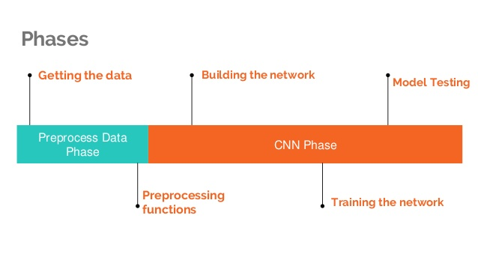

Slide 5
Training Methodology
Some steps for training the model are:-
Step 1 :- Firstly we select the target data feature.
Steps 2 :- After it we divide the dataset into train and test data
Steps 3:-Then we train the model using CNN.
Step4 :- Then we predict our output using test data.

Slide 6
Convolution Neural Network :-
1) What is convolution ?
2) What is neural Network?
3) What is Convolution Neural Network?
4) Architecture of traditional CNN
5) Types of layers
6) Padding
7) Data Augmentation

Slide 7
What is convolution ?
Convolution is the first layer to extract features from an input image. Convolution preserves the relationship between pixels by learning image features using small squares of input data. It is a mathematical operation that takes two inputs such as image matrix and a filter or kernel.

Slide 8
What is neural Network?
Neural networks reflect the behavior of the human brain, allowing computer programs to recognize patterns and solve common problems in the fields of AI, machine learning, and deep learning.

Slide 9
What is Convolution Neural Network?
A convolutional neural network, or CNN, is a deep learning neural network designed for processing structured arrays of data such as images.

Slide 10
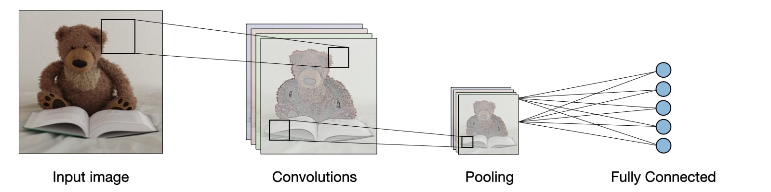
Architecture of a traditional CNN

Slide 11
Types of layer
1) Convolution layer (CONV):-
Convolution is the first layer to extract features from an input image. Convolution preserves the relationship between pixels by learning image features using small squares of input data. It is a mathematical operation that takes two inputs such as image matrix and a filter or kernel.

Slide 12
Convolutional layers are the layers where filters are applied to the original image.

Slide 13
2) pooling Layers
Pooling layers are used to reduce the dimensions of the feature maps. Thus, it reduces the number of parameters to learn and the amount of computation performed in the network. The pooling layer summarises the features present in a region of the feature map generated by a convolution layer.

Slide 14
Pooling (POOL) :-
-The pooling layer (POOL) is a downsampling operation.
Type
Max pooling
Average pooling
Purpose
Each pooling operation selects the maximum value of the current view
Each pooling operation averages the values of the current view
Illustration

Slide 15
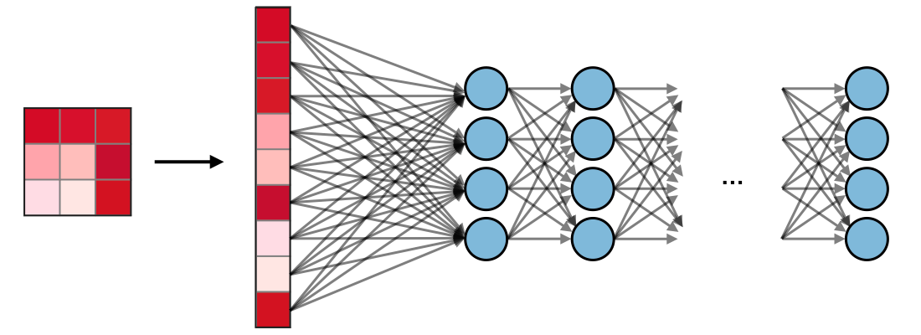
3) Fully Connected (FC)
The fully connected layer (FC) operates on a flattened input where each input is connected to all neurons. If present, FC layers are usually found towards the end of CNN architectures and can be used to optimize objectives such as class scores.

Slide 16
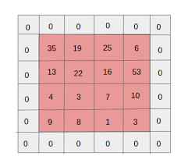
Padding
Padding is a term relevant to convolutional neural networks as it refers to the amount of pixels added to an image when it is being processed by the kernel of a CNN. For example, if the padding in a CNN is set to zero, then every pixel value that is added will be of value zero.
Ex : -

Slide 17
Data Augmentation
Data augmentation is a strategy that enables practitioners to significantly increase the diversity of data available for training models, without actually collecting new data. Data augmentation techniques such as cropping, padding, and horizontal flipping are commonly used to train large neural networks

